Slide 1
Content Based Analysis in order to Detect SensitiveData P202106
Batuhan TATLISERT 201811057
Nazım DÖLEKÇEKİÇ 201811026
Alper PUNAR 201711055
Beril YOKARIBAŞ 201811069
Instructor Dr.Ayşe Nurdan SARAN

Slide 2
Content
1-Introduction 3- E-mail Relay
1.1-Problem Definition 4- Constructing DLP
1.2-DLP 4.1-Admin Interface
1.3-NLP 4.2-E-mail Service Interface
1.4-BERT
1.5-LaBSE
2-Proposed Solution
2.1-Data
2.2-OCR
2.3-Tokenize&Vectorize
2.4-Classification
2.5-Model Testing

Slide 3
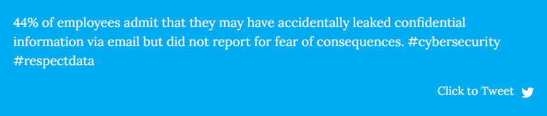
1. Introduction
Data must be stored and protected against any kind of threat. Especially for intruder attacks.
Lots of things can threaten security.
DLP (Data Leakage Prevention) systems can increase security against data leakage
Notes:
mahmut

Slide 4
1.1-PROBLEM DEFINITION
DLP systems are used to protect data against unauthorized disclosure.
In our project, we are going to build a text classification application by natural language processing and classify our documents with confidence scores in order to detect sensitive data.
Notes:
mahmut

Slide 5

1.2-DLP

Slide 6
1.2-DLP
DLP is the abbreviation of Data Leakage Prevention.
Data Leakage (DL) means unauthorized or unwanted disclosure of the data.
DLP systems are used to protect sensitive data from being leaked to the public.
DLPS’s aim is to prevent this leakage differently from traditional protection measures. DLPSs are content-aware.
In our project, we mainly focused on e-mail DLP’s.

Slide 7

1.3-NLP

Slide 8
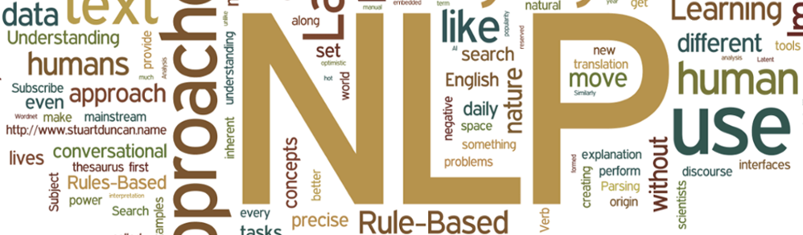
1.3-NLP
NLP is the abbreviation of Natural Language Processing.
NLP makes computers understand human language.
Examples of NLP: Google Assist, Alexa, and Siri.
NLP uses machine learning.
Language morphology levels are morphological lexical, syntactic, semantic, and pragmatic discourse.

Slide 9
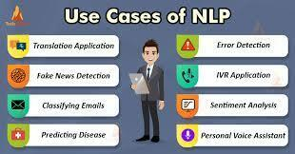
1.3-NLP
Examples of NLP: Information Retrieval, Character Recognition, Spell Checking, Machine Translation, Dialogue Systems.
In our project, we are going to build a text classification application by natural language processing and classify our documents with confidence scores in order to defect sensitive data.

Slide 10
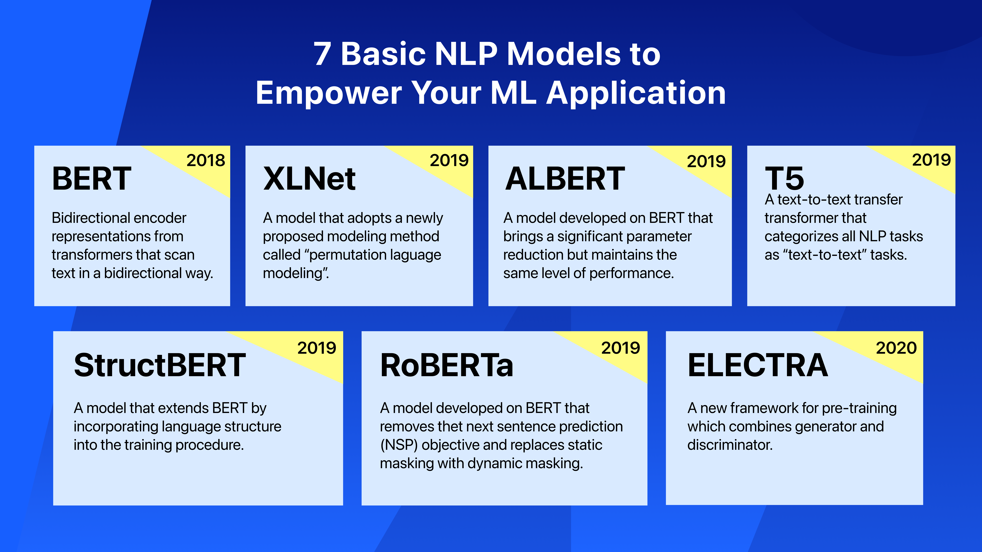

Slide 11
1.4-BERT
BERT stands for Bidirectional Encoder Representations from Transformers
It is developed by Google.
BERT uses a bidirectional transformer instead of a dictionary transformer.
Bidirectional models can have a deeper sense of context.
Bert can be used for tasks like sentiment analysis, text summarization, question answering, etc.

Slide 12
1.5-LaBSE
LaBSE stands for Language-Agnostic Bert Sentence Embedding.
Different from BERT LaBSE is a multilingual model.
It can work with training data sets that have different languages.

Slide 13
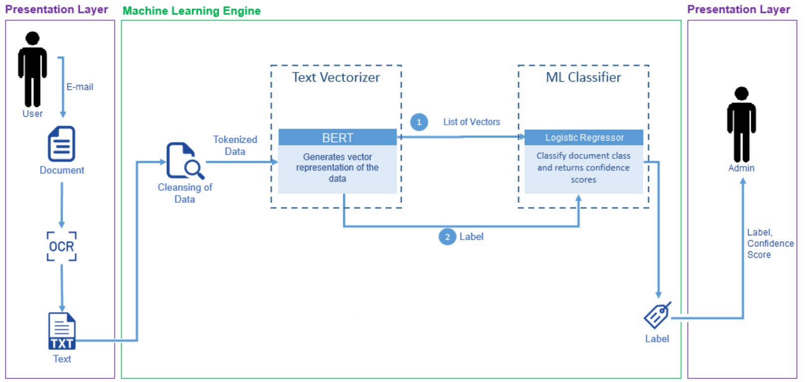
2. Proposed Solution

Slide 14
2. Proposed Solution

Slide 15

2.1 –Data

Slide 16
2.1 –Data
We have found secret data from search.edwardsnowden.com.
Our secret data consists of 2225 entries and comes from various agencies, mainly NSA. We used 1600 of them for training the model and 625 of them for testing the model.
Public data comes from NSA news and NATO news so the contents of secret and public datasets can be more closely related. It has 1600 entries.
We split the training data into %80 for training and %20 for testing.
For the testing of the model after creation, we found data from BBC and two other public data sets.
We have conducted cleaning operations for the data sets.

Slide 17

2.2 – OCR (Preparing data, transforming to text)
Transforming document’s (doc, pdf, pptx …) content to text.
Tesseract
Tested it with images and documents.

Slide 18
2.3 –Tokenize and Vectorize
BERT (LaBSE) is used for both of these operations.
We managed to directly jump into the tokenizing process without the cleansing of data because preprocessing layer will handle this task.

Slide 19
Proposed Solution

Slide 20
2.4 Classification
We conducted our tests as binary classification. Secret or not secret, public.
We added a 0.1 dropout layer and a dense layer with a sigmoid activation function to the BERT layer.
We tried various activation functions such as softmax, tanh, sigmoid functions.
We added a dense layer to convert the pooled output into binary output with the help of the sigmoid function.
We changed the learning rate from 1e-4 to 1e-5.

Slide 21
2.5 – Model Testing
BBC False Negative Table
BBC | Total Entry Number | Falsely Classified | Percentage
Business | 510 | 20 | %3,92
Entertainment | 386 | 20 | %5,18
Politics | 417 | 9 | %2,16
Sport | 511 | 1 | %0,20
Tech | 401 | 27 | %6,73
Pozitive : Secret
Negative : Public

Slide 22
2.5 – Model Testing
Two Public Data Sets False Negative Table
Public Data Sets | Total Entry Number | Falsely Classified | Percentage
Food | 100 | 18 | %18
Maths | 214 | 10 | %4,67
Two Public Data Sets False Positive Table
Secret Entries | Total Entry Number | Falsely Classified | Percentage
Secret Data Set | 625 | 12 | %1,92
Pozitive : Secret
Negative : Public

Slide 23
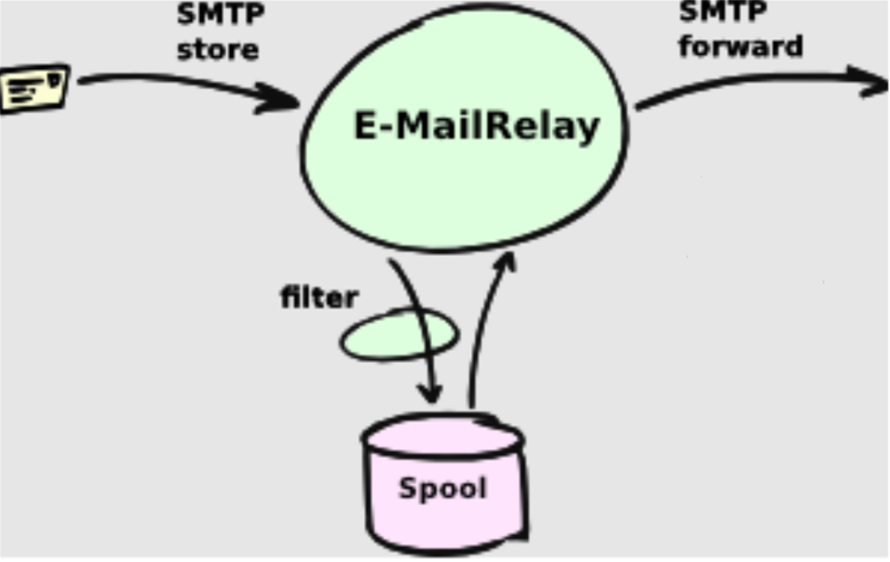
3 – E-mail Relay
SMTP mail relay is the process of transferring an email from one server to another for delivery.

Slide 24
3 – E-mail Relay

Slide 25
4 – Constructing DLP
The E-mail that is going to be sent will be turned into plain text by OCR. After that, it will be sent to the model.
If the model decides it contains sensitive information and it is above the threshold Admin will be warned.
Admin will decide what to do with this mail. He/she can decide according to company regulations.

Slide 26
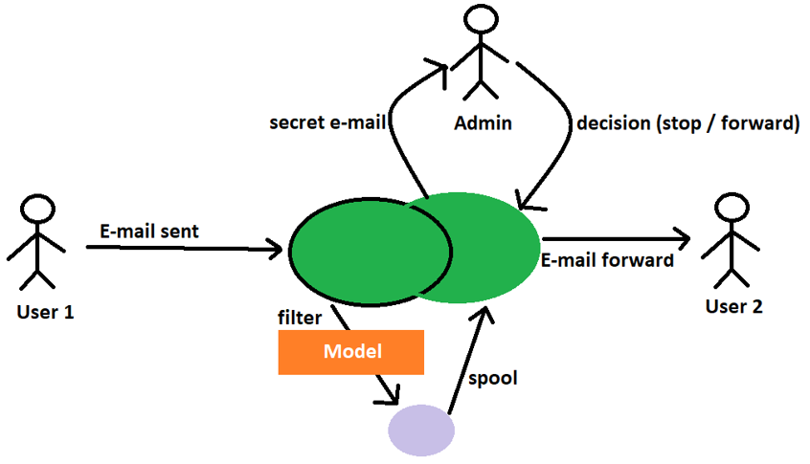
4 – Embeding into DLP

Slide 27
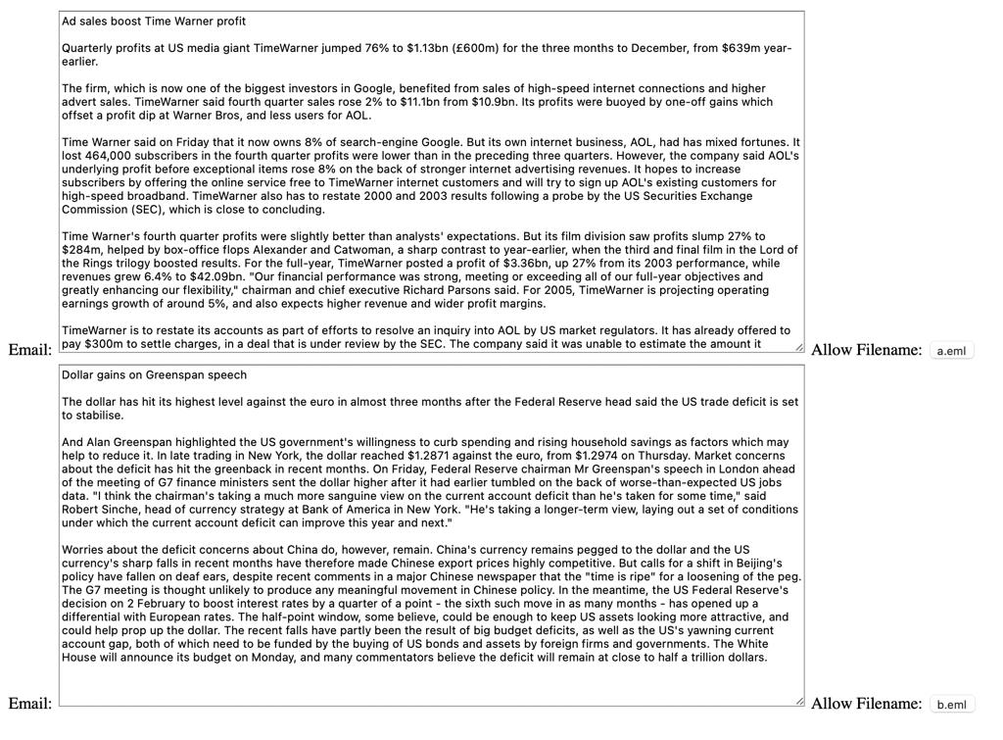
4.1 – Admin Interface

Slide 28
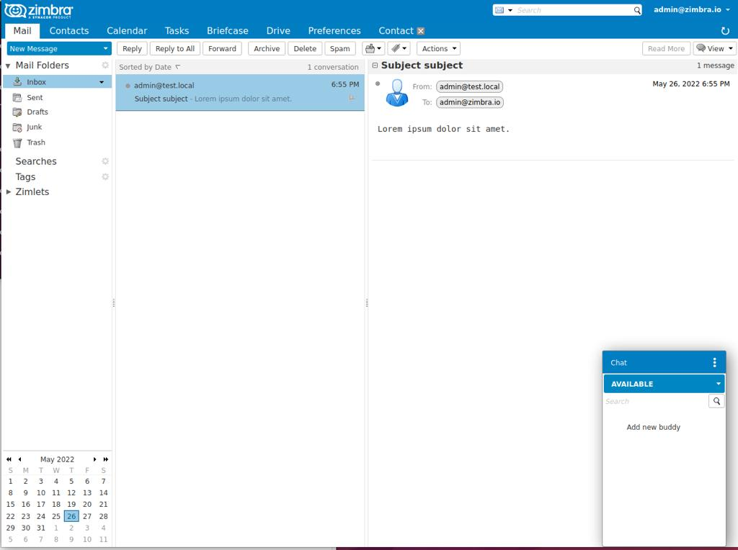
4.2 – E-mail Service Interface

Slide 29
Thank you for listening

